Slide 1

Introduction to Machine Learning
RS School 2022 Q1

Slide 2

If we have data, let’s look at data. If all we have are opinions, let’s go with mine. ©Jim Barksdale

Slide 3
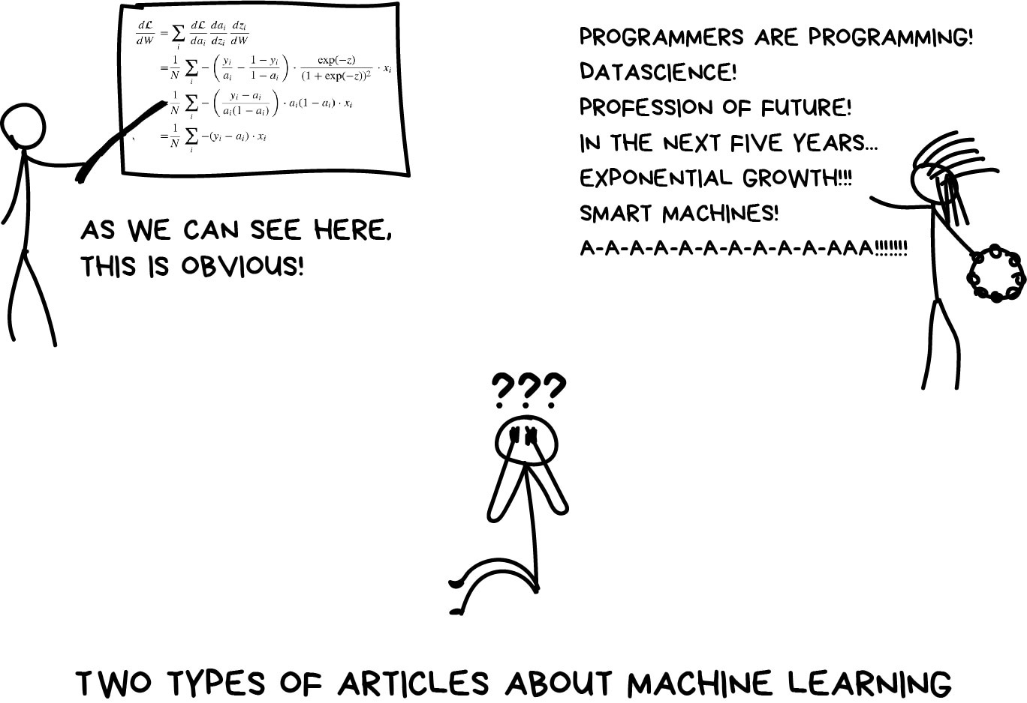
What is Machine Learning?

Slide 4

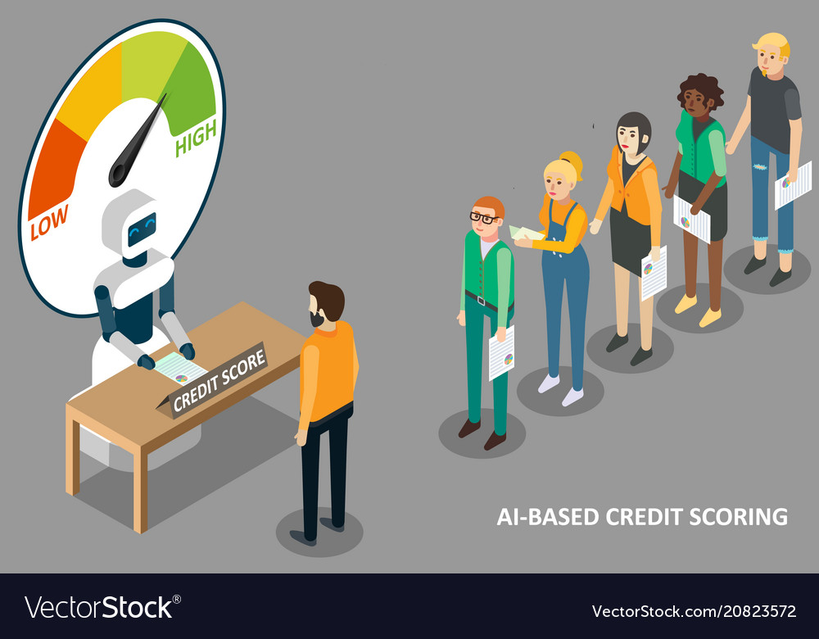
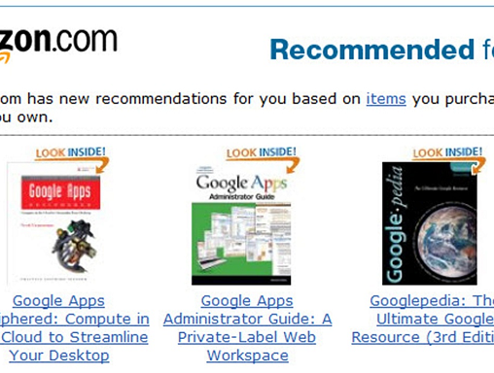
Where is Machine Learning?
Credit scoring
Virtual personal assistant
Credit scoring
Recommendation systems

Slide 5


If all your friends jumped off a cliff, would you do it too?
Regular boy
AI boy
Of course no, mom
Sure, I would

Slide 6

The sexiest one
But not exactly…
Harvard Business Review named Data Scientist the sexiest job of the 21 century. But they didn’t know that 70% of the time we are spending on collecting and cleaning the data rather than finding business insights.

Slide 7

What does machine learning involve
Cross-Industry Standard Process of Data Mining
In our course we suppose to have a business understanding
Focus on Data Understanding, Data Preparation, and Modeling
Evaluation is a more complex process than it might seem at first glance. We cover the basic cases
Basics of deployment are waiting for you in the capstone project

Slide 8
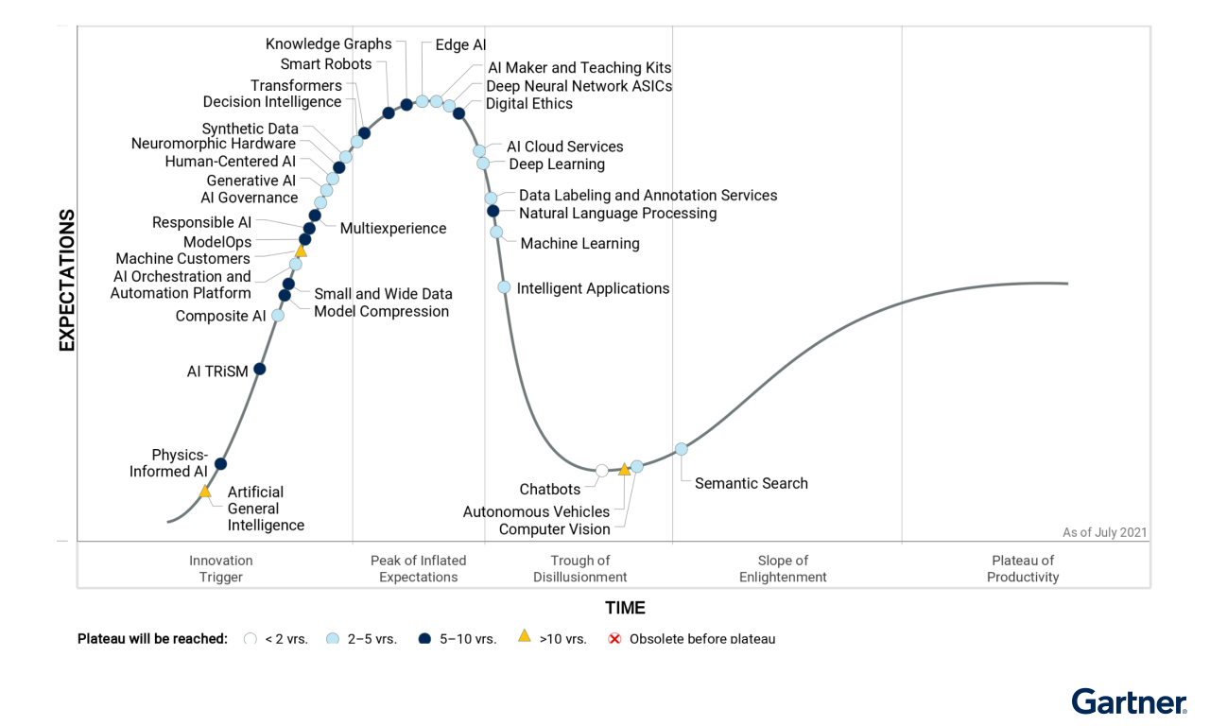
Gartner Hype cycle for Artificial intelligence

Slide 9


Course goals
Shape the concept of what machine learning is
Enable the student to acquire basic ML competence for further independent study and research
Prepare the student for applying ML to real-world problems and use it in practice (including Capstone project)

Slide 10



Prerequisites
Fundamentals, Strings, Arrays, Regular Expressions, OOP, etc.
Python basics
Euclidean space, matrix and vector transformations, matrix determinant, vector norms, derivatives, gradient, etc.
Linear algebra and calculus
Random variable distributions (uniform, normal), variance, covariance matrix, expected value, etc.
Probability and statistic

Slide 11
Course structure
Overview
Program:
Introductory lecture + knowledge test (programming and math)
8 modules, one per week starting from 14th February
Capstone project
Necessary links:
Course Git https://github.com/rolling-scopes-school/ml-intro
Course Discord server https://discord.gg/c2dzBeMyVA
Course RS APP registration https://app.rs.school/registry/student?course=ml-intro-2022Q1
RS School documentation https://docs.rs.school/#/README

Slide 12
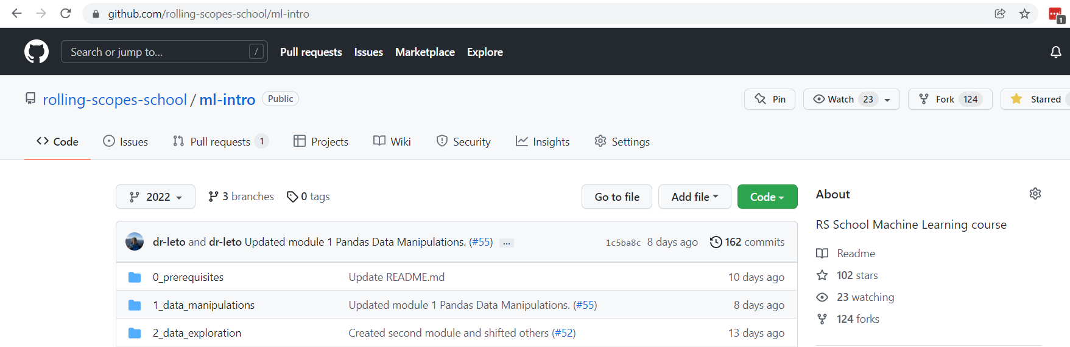
Course Github
In detail
Used for sharing all up-to-date course materials including assignments, lectures, links to books and papers, tests and etc.
Do not forget to fetch changes regularly – repo is constantly updated!
Feel free to create an issue / pull request if you see fit, instruction https://docs.rs.school/#/fix-typo

Slide 13
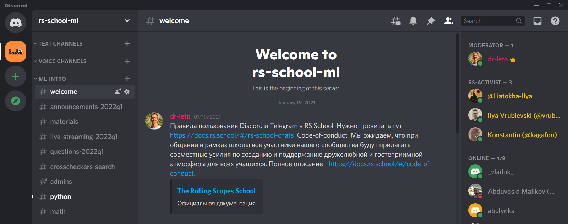
Course Discord Server
In detail
Used for any type of communication: formal, informal, random, questions. Just try to adhere to the elementary rules of decency and choose the appropriate channel.
All the necessary information on the current module, assignments, and deadlines is posted in announcements-2022q1

Slide 14
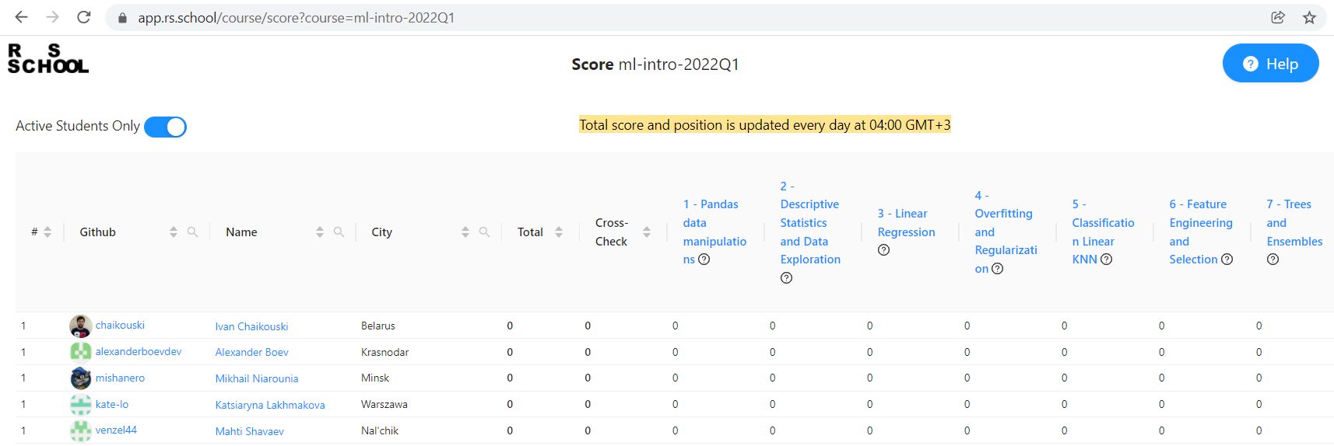
Course RS App
In detail
Here you should submit tasks for verification, get cross-checks and view your assignment scores

Slide 15
Some important notes
Meet the deadlines!
No cheating allowed. You may create two GitHub accounts for cross-checks
Study theory hard in parallel with doing the graded assignments

Slide 16







Many thanks to everyone who make that come true
Ivan Kravchenko
Daniil Biruk
Alex Trofimov
Dmitry Sermyagin
Dmitry Kurch
Yuliya Malakhovskaya
Vlad Astrashab

Slide 17
Good luck, Have fun!

